Slide 1
Snake Game Presentation
Group 2 Member: Zhao Wei, Liu Wanpeng
Presented by: Zhao，Liu
Date:29/12/2024
Notes:
Our team made the New Snake game using the Winbgim graphics library

Slide 2
Process
Overview 3
Game Introduction 4
Game Inspiration 5
Design introduction 6
Game screen introduction 9

Slide 3
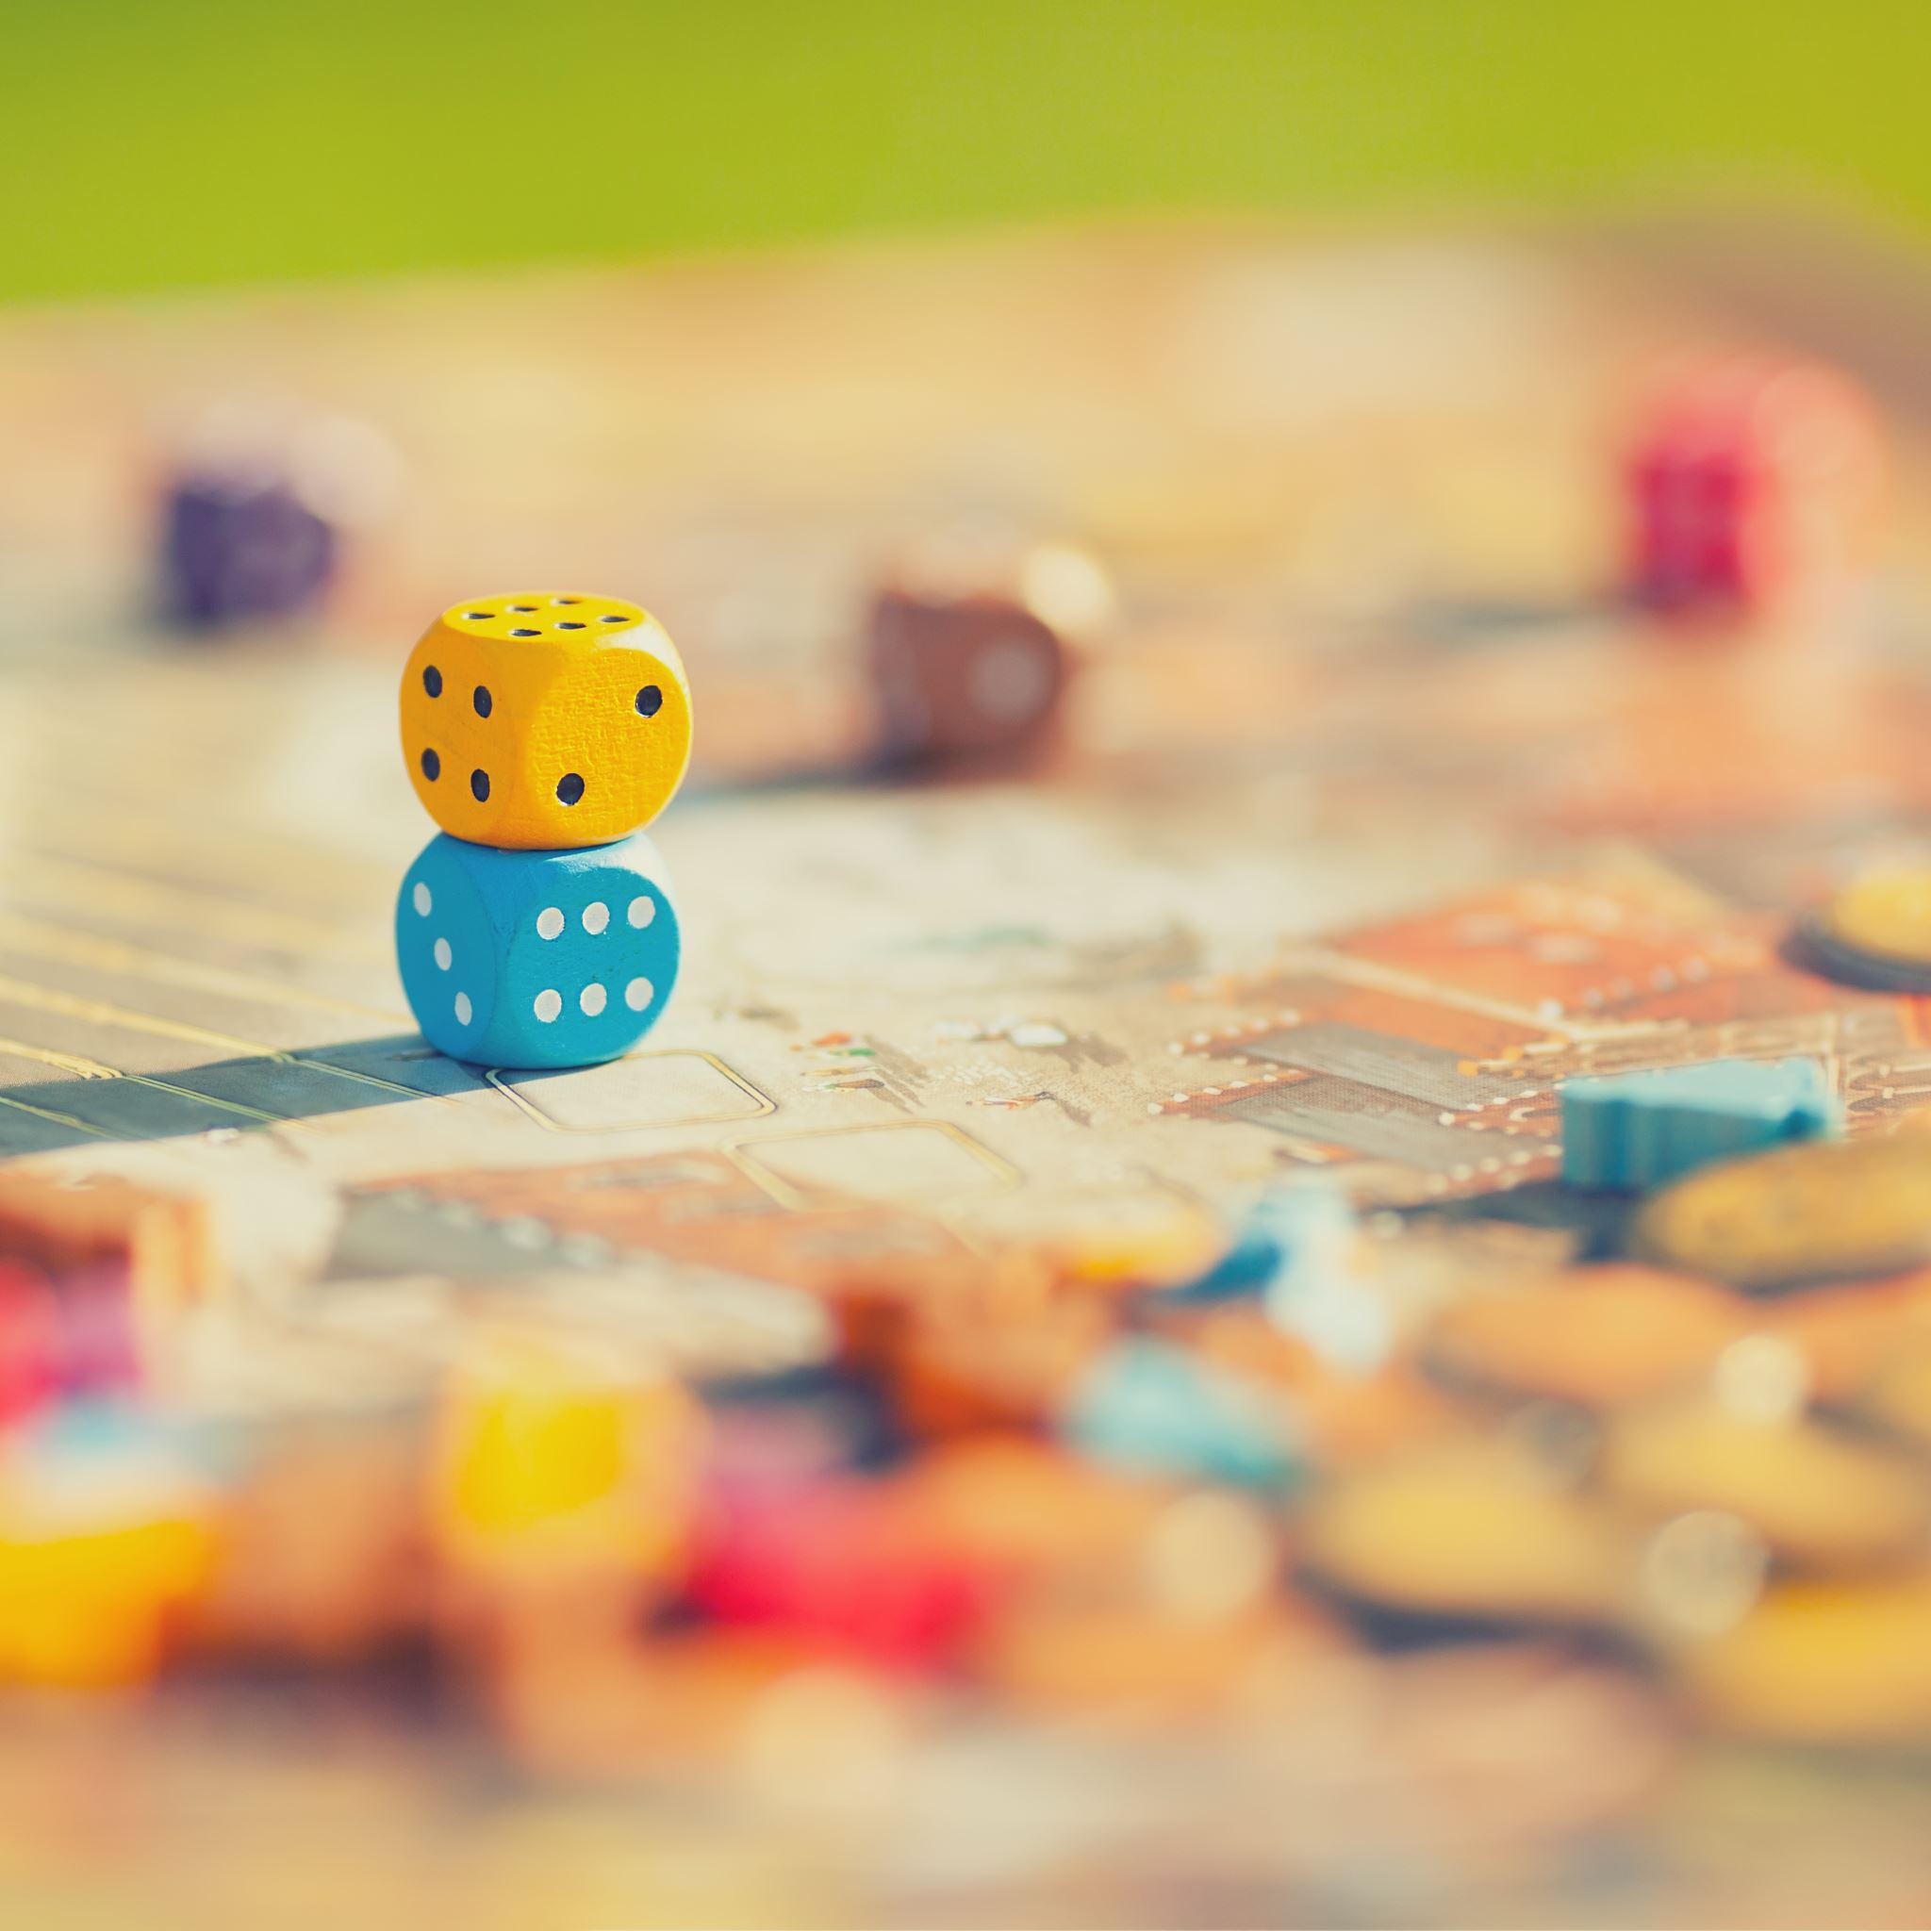
Mission
Liu Wanpeng：
Design and implementation of snake class (Snake.h and snake.cpp).
Analyze the functionality of the Snake class, including its properties and methods.
Zhao Wei：
Design and implementation of game classes (Game.h and game.cpp).
Analysis and management of the overall game logic.

Slide 4
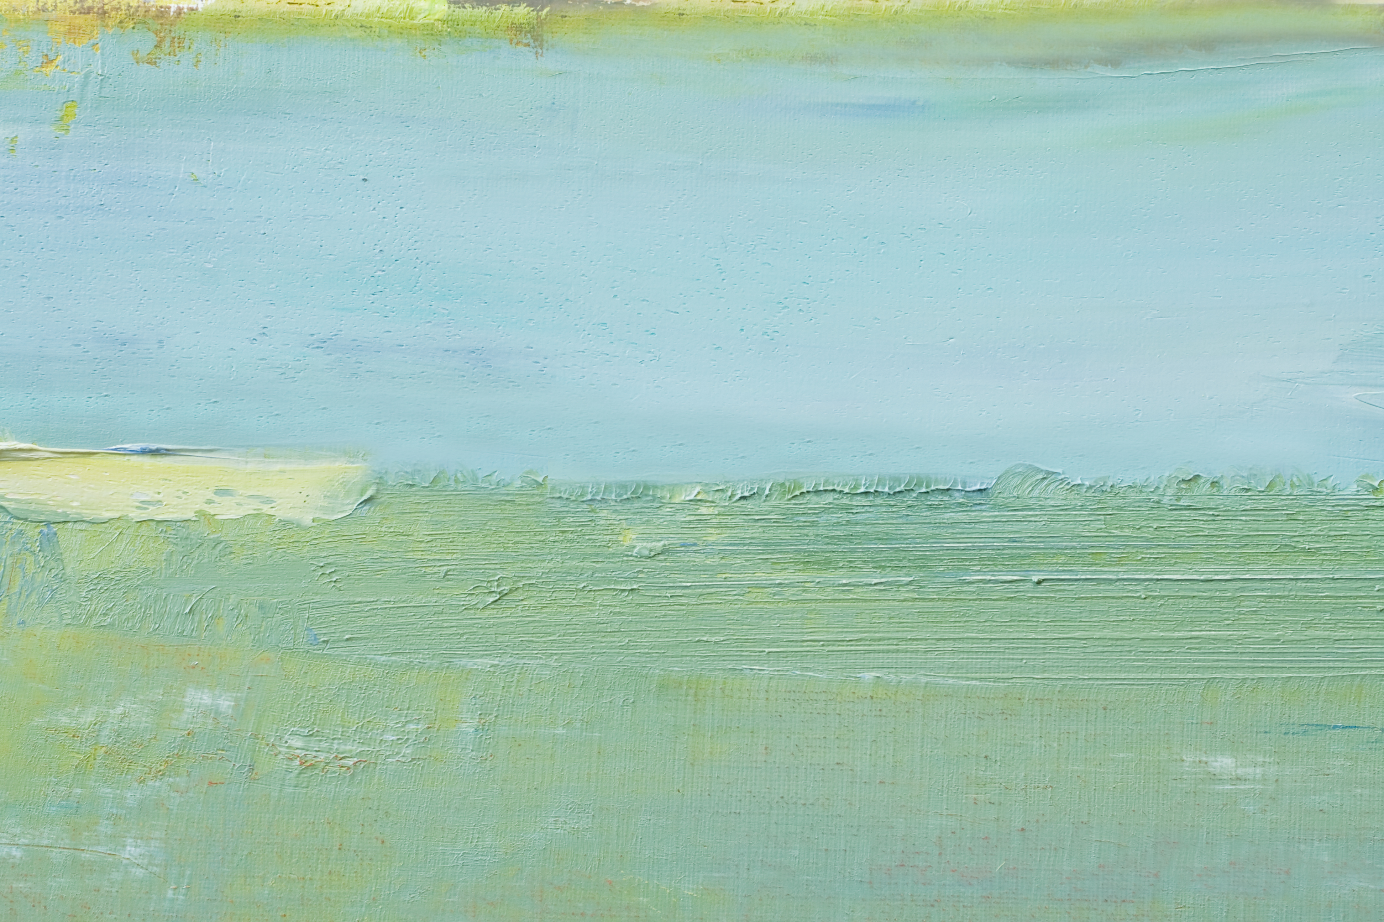
Game Introduction
Game title ：New Gluttonous Snake
Game goals:
The player must control the snake to eat the food that appears on the map, making the snake longer while avoiding obstacles and map boundaries.

Slide 5
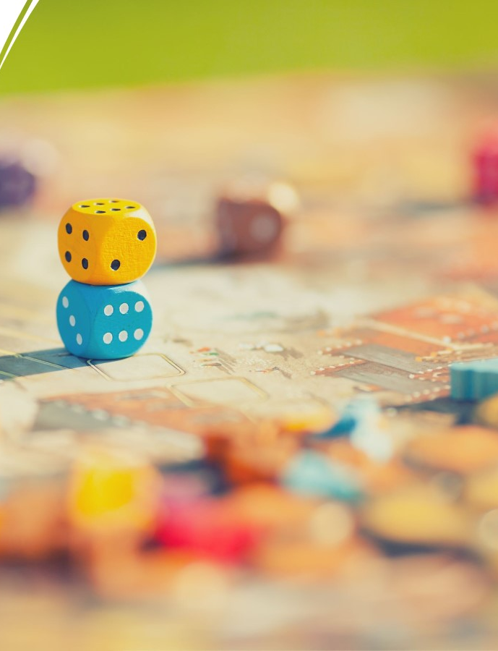
Game Inspiration
We referred to the classic snake gameplay, but considering that the classic snake is too simple, we added several new mechanisms, such as eating a red food will score 10 score, and eating a black food will deduct -5 score, and some obstacles will be added to the map, and if the snake's head touches, it will die directly. Make the game more fun and challenging by integrating classic gameplay with new game mechanics.

Slide 6
Design introduction

Slide 7
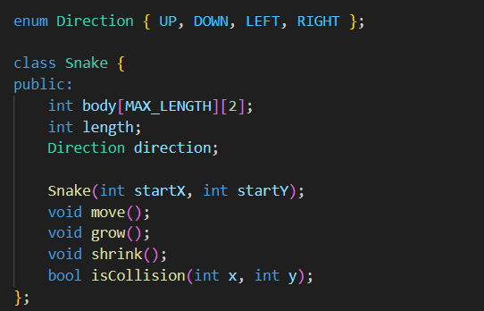
Class Design--- Snake Class
The Snake class represents the snake in the game, encapsulating its core properties and behaviors such as position, length, movement direction, and interactions with other game elements.

Slide 8
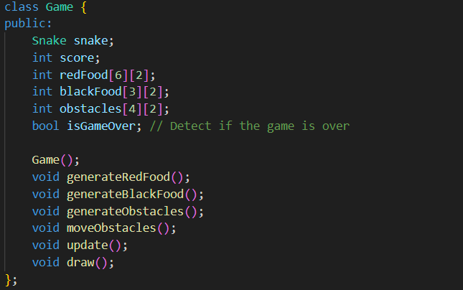
Game class
The Game class acts as the central controller of the game, managing the snake, food, obstacles, and the overall game logic and state.

Slide 9

Interaction design in the main function
Start or exit the game with a mouse click.
Control the movement of the snake through the up and down left and right keys on the keyboard.
Press Esc to exit the game directly
When the game mechanic dies, the game is over, and the score is displayed.
Notes:
When you run the exe, the menu interface of the game will be displayed, you can click to start the game or leave the game, click to start the game, you can control the movement of the snake through the up and down left and right keys. And when you press ESC you can exit the game directly.

Slide 10
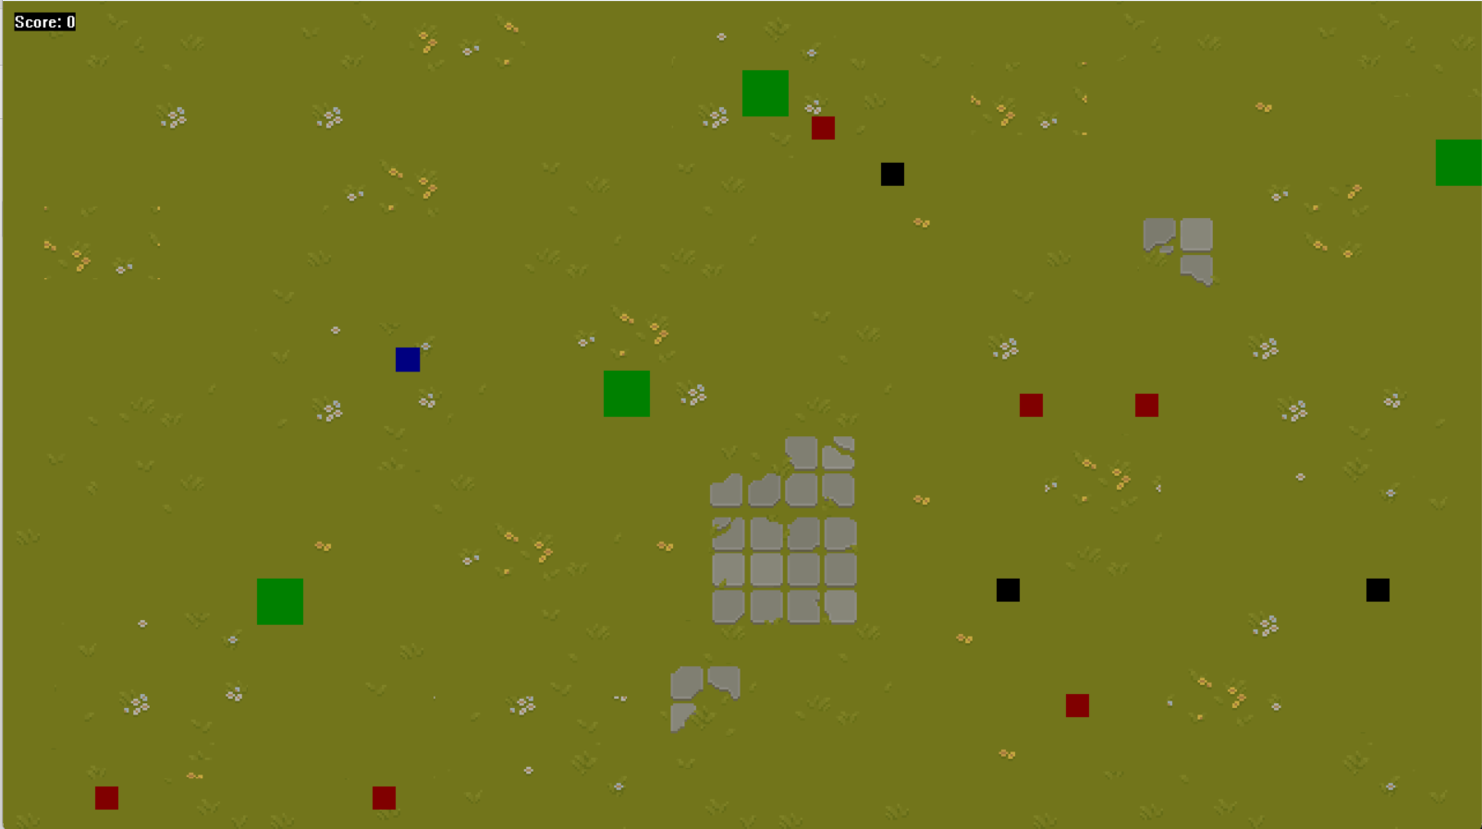
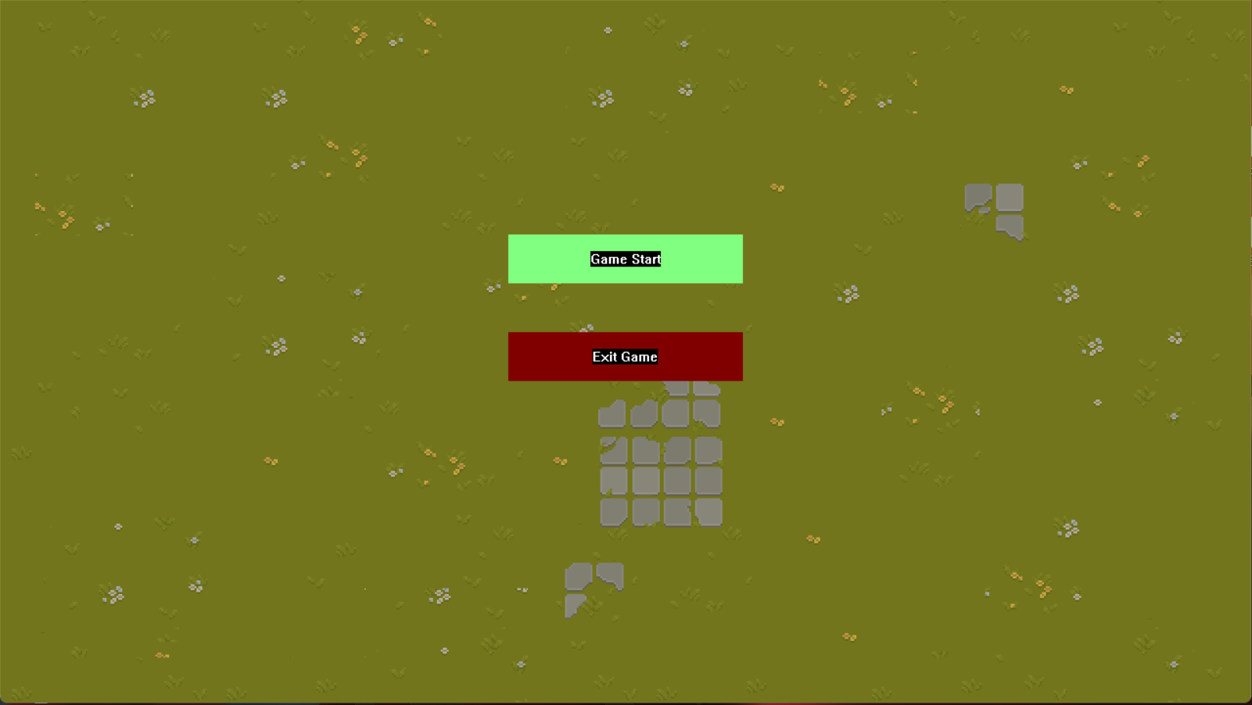
Game screen introduction

Slide 11
The game operates in a 1280×720 resolution window, with a background loaded from an image file named "b1.bmp“(The picture is in the file). The game scene is structured as a two-dimensional array, providing a grid-based environment for gameplay elements such as the snake, food, and obstacles.
Notes:
The width of the game window is 1280 and the length is 720. The entire game operation is implemented in a two-dimensional array.

Slide 12
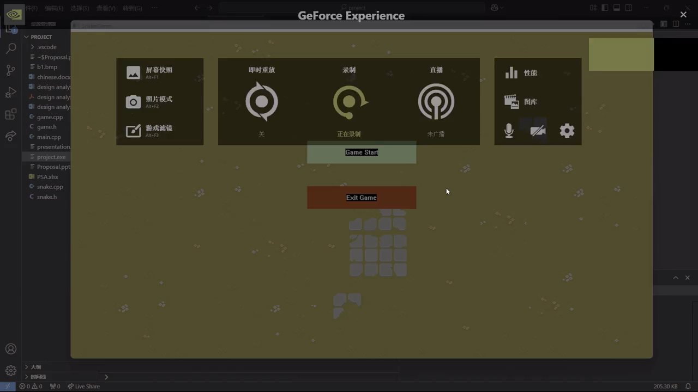
What do the squares of different colors and sizes represent in the picture?
 The blue square represents the snake.
Demo video
 The red square means that eating good food can increase your size and score points.
 The black square means that eating bad food will reduce your size and subtract points.
 The green blocks represent obstacles that move randomly up and down, left and right, and will kill the snake if it hits them.

Slide 13
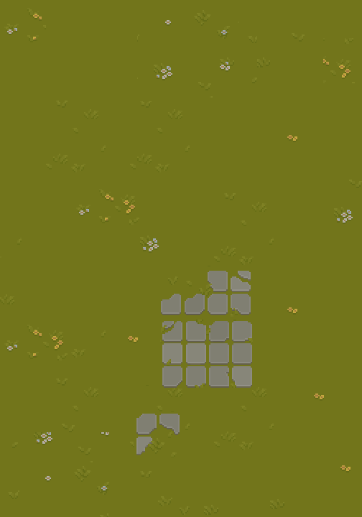
TKANK YOU!!!

